Slide 1
Human Rights Training Tool

Slide 2
Training Objectives
Develop a better understanding of the corporate responsibility to respect human rights relevant for the oil and gas industry.
Develop a better understanding of key human rights issues relevant for the oil and gas industry.
Reinforce [Insert company name] expectations and requirements related to human rights.
Be familiar with resources to help manage potential
human rights issues.

Slide 3

Training Overview
Part 1: Basics on Human Rights
  What are Human Rights?
  Who is responsible for protecting human rights?
  What are the business reasons for respecting human rights?
  What is the expectation of our company regarding human rights?
Part 2: Key Human Rights Issues for the Oil and Gas Industry
  Employee / Labour Relations
  Provision of Security to Protect People and Assets
  Community Engagement
  Supplier Engagement
Part 2: Key Labour Issues for the Oil and Gas Industry
  Labour Issues
  Supply Chain Focus
  Labour Issues Dilemmas for Discussion

Slide 4
Part 1
Basics on Human Rights

Slide 5

What are Human Rights?
Human rights are generally defined as basic standards of treatment to which all people are entitled, regardless of nationality, gender, race, economic status or religion.

Slide 6
Who is responsible for protecting human rights?
Governments have the primary duty to protect and ensure the fulfilment of human rights.
Governments have the ability to implement and enforce local laws that protect human rights.
Companies have a responsibility to respect human rights.
Complying with applicable laws and regulations.
Having a due diligence process in place to manage potential human rights issues and impacts from company operations – either directly or indirectly through involvement with third parties (e.g. suppliers).
Governments and companies should provide access to remedies.
Governments should provide effective and appropriate judicial (e.g. courts) and non-judicial mechanisms for stakeholders to access remedies related to business and human rights-related harm.
It is recommended that companies provide stakeholders (e.g. communities) access to channels to raise human rights-related grievances related to company operations and remedies.

Slide 7

What are the business reasons for respecting human rights?
Protects people and assets.
Prevents disruptions to business operations.
Contributes to stable operating environments.
Maintains positive relationships with the government, communities, and other key stakeholders.
Recruitment and retention of employees.
Enhances company reputation.

Slide 8
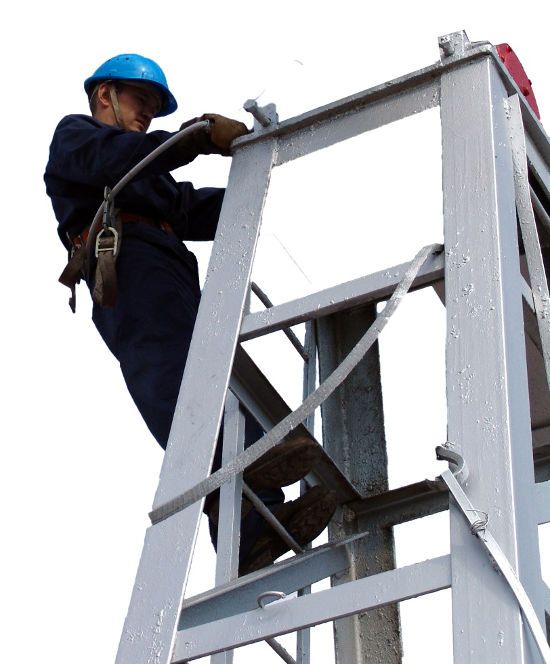
[insert company name] expectations regarding human rights
Insert high level company expectations
Potential Examples:
  Human Rights policy
  CSR policy
  Human Rights statement
  Company ‘code of conduct’

Slide 9
Part 2
Key Human Rights Issues for the
Oil and Gas Industry

Slide 10
1. Employee / Labour Relations
Companies are expected to treat all workers with respect and dignity and promote diversity in the workplace.
Company policies and practices should (i) adhere to all applicable domestic laws; and (ii) are generally expected to be consistent with the International Labour Organization’s (ILO) Core Labour Conventions, in particular:
  Freedom of association and the right to collective bargaining
  Elimination of forced and compulsory labour
  Abolition of child labour
  Elimination of discrimination in the workplace
  Promotion of healthy and safe working conditions for employees

Slide 11
[insert company name] expectations regarding Employees and Labour Relations
Insert company human resource or labour relations policies or guidelines

Slide 12
2. Provision of Security
Companies are expected to provide security to protect personnel and assets in a manner that respects human rights of staff and community members.
The issues focus on respect for civil and political rights, such as freedom from arbitrary arrest and detention, cruel, inhumane or degrading treatment.
Company policies and practices are generally expected to be consistent with international principles, such as United Nations Use of Force Guidelines or the Voluntary Principles on Security and Human Rights, particularly:
  Contracting private security
  Engaging with public security
  Conducting assessment of potential risks and issues associated with the provision of security
  Appropriate training and support (non-lethal) provided to security providers

Slide 13
[insert company name] expectations regarding Provision of Security
Insert description of company policies or guidelines on security provision. [Note: your legal team should be consulted before examples are used. Documentation might be confidential or privileged.]
Potential Examples:
  Contractual provisions with private security firm
  Assessment of potential risks associated with the provision of security
  Incorporation of security and human rights expectations into project documents
  Building internal awareness on managing security in a manner that respects human rights
  Training security providers
  Building relationships with security providers
  Engaging with local communities about security arrangements
  Monitoring of security arrangements
  Establishing and maintaining a process of reporting alleged human rights issues by security providers
  Monitoring the transfer and use of equipment provided by the company

Slide 14
3. Community Engagement
Potential community human rights issues include impacts on water quality and access, land access, livelihoods, employment, vulnerable groups, and preservation of cultural heritage.
Companies may mitigate issues by:
engaging in meaningful consultation with communities and fostering ongoing two-way communication about project impacts and benefits to achieve durable solutions.
proactively building relationships, goodwill and trust with communities and other key stakeholders where they operate, throughout the lifecycle of a project.
Integrating company processes that identify, mitigate, and track potential impacts and human rights issues throughout the lifecycle of a project into project planning.
Company resources may also contribute to social and economic development in the communities where they operate to support the fulfilment of human rights (e.g. helping improve access to basic human needs and livelihood opportunities).

Slide 15
[insert company name] expectations regarding Community Engagement
Insert description of company policies or guidelines on community engagement, impact management, and issues management.
[Note: your legal team should be consulted before examples are used. Documentation might be confidential or privileged.]
Potential Examples:
  Stakeholder engagement process
  Project impact assessment process (e.g. Environmental, Social, Health Impact Assessments or ESHIA)
  Human Rights impact assessment tool or process.
  Involuntary resettlement procedures
  Engagement with vulnerable groups (e.g. indigenous peoples)
  Social investment programs

Slide 16
Focus Issue: Indigenous Peoples
Oil and Gas projects may come into contact with Indigenous Peoples, who hold specific rights under international law and in many national legislative contexts.
Potential human rights issues may also include the rights of minorities, right to self determination, and right to a cultural life.
Companies will want to consider these specific rights when engaging with Indigenous Peoples and informing them about potential impacts, benefits, and plans. Companies are advised to engage in meaningful consultation to mitigate issues.
Issues to consider include:
  Effective consultation
  Historical land attachments and rights to the lands traditionally occupied
  Land use, management and conservation of natural resources
  Resettlement
  Distinct spiritual values and cultural, religious, economic and political practices

Slide 17
Focus Issue: Resettlement
Projects that require access to acreage may trigger a resettlement of communities.
Resettlement takes place if homes, shelters, or sources of income within a community (e.g. fishing or farming) are located on land or in marine areas needed for project development and operations.
Potential human rights issues may include the right to a standard of living and to own property.
Companies may mitigate issues by:
Using informed decision-making where practicable in project planning on resettlement:
  Avoid the need for resettlement or reduce the scope of resettlement required
  Replace land with land
  Replace assets with assets
  Provide monetary compensation if above is not practicable
Engaging in meaningful consultation communities are properly informed about potential impacts, benefits, and plans
Developing ongoing monitoring for mitigation measures

Slide 18
4. Supplier Engagement
Potential supplier human rights issues may include worker rights such as freedom of association, collective bargaining, forced and compulsory labour, child labour, discrimination in the workplace, working conditions (e.g., health and safety), and impacts on local communities.
Companies may mitigate issues by:
  Encouraging suppliers to treat their employees, and to interact with communities, in a manner that respects human rights.
  Requiring in company policies and practices that key suppliers adhere to all applicable domestic laws
  Encouraging suppliers to be consistent with ILO core labour principles
Opportunities to engage with suppliers may include:
  Supplier meetings and forums
  Contracting
  Company’s supplier engagement or management process (e.g. bidding, pre-qualification, contracting, training).

Slide 19
[insert company name] expectations regarding Supplier Engagement
Insert description of company policies or guidelines on supplier engagement.
[Note: your legal team should be consulted before examples are used. Documentation might be confidential or privileged.]
Potential Examples:
  Contractual provisions with key suppliers
  Due diligence processes
  Training and other capacity building programs
  Communications materials

Slide 20
External Resources
IPIECA – www.ipieca.org
Indigenous Peoples and the oil and gas industry: context, issues and emerging good practice
Guide to successful, sustainable social investment for the oil and gas industry
Voluntary Principles on Security and Human Rights: Implementation Guidance Tool
A guide to social impact assessment in the oil and gas industry
External
Voluntary Principles on Security and Human Rights
http://voluntaryprinciples.org
International Finance Corporation (IFC) Performance Standards
http://www1.ifc.org/wps/wcm/connect/topics_ext_content/ifc_external_corporate_site/ifc+sustainability/publications/publications_handbook_pps
United Nations Guiding Principles on Business and Human Rights
http://www.ohchr.org/documents/issues/business/A.HRC.17.31.pdf
International labour Organization Core labour Standards
http://www.ilo.org/global/standards/subjects-covered-by-international-labour-standards/lang--en/index.htm

Slide 21
Company Resources
Insert company resources
[Note: your legal team should be consulted before examples are used. Documentation might be confidential or privileged.]
Potential Examples:
  Links to supporting Policies
  Links to supporting Guidelines
  Links to Operational Procedures
  Names of personnel with role and responsibility (e.g. Head of Security, Human Resources advisor, Human Rights advisor, Social Performance advisor)

Slide 22

Recap and Quiz
What are Human Rights?
How should companies demonstrate respect for human rights?
What are the business reasons for respecting human rights?
What are the key human rights issues for our industry?
What are the expectations of our company regarding human rights?

Slide 23
Part 3
Introduction: Key Labour Issues for the Oil and Gas Industry

Slide 24
Overview
International Labour Organization (ILO) – Declaration on Fundamental Principles and Rights at Work
  Freedom of association and the right to collective bargaining
  Effective abolition of child labour
  Elimination of all forms of forced labour, including human trafficking
  Elimination of discrimination in respect of employment and occupation

Slide 25
Business Case
Minimize business disruptions caused by poor labour practices: working with suppliers to improve their labour practices reduces the risk of poor quality or disruptions to operations
Recruitment and retention: respecting the labour rights of employees boosts recruitment of suppliers’ labour forces and improves staff retention – all of which benefit a company’s overall operations and saves money
Reputational: Supplier behaviour reflects directly on a company – either positively or negatively. Many companies have publically committed to respecting human rights in their supply chain
Notes:
Business disruptions, delays and value erosion: Goldman Sachs 2008 study indicates that time for projects to come online has nearly doubles in the last decade, significantly increasing costs.

Slide 26
What is Freedom of Association and Right to Collective Bargaining?
“Everyone has the right to form and join trade unions for the protection of his interest.”
- Universal Declaration on Human Rights, Art. 23(4))
Freedom of association is the "key element in ensuring respect for other fundamental rights at work“
- International Labour Organization

Slide 27
Freedom of Association and Collective Bargaining: Key Elements
Freedom of association and right to collective bargaining refers to the right of workers to establish, join and administer organizations on their own to represent their occupational interests
Suppliers should recognize and respect the right of employees to form labour unions and bargain collectively, where such rights are recognized by local law
Suppliers can respect this right by not interfering in the internal affairs of these organizations, inappropriately influencing their decisions, or discriminating against workers who are engaged in such activities

Slide 28
Freedom of Association and Collective Bargaining: Key Elements (cont.)
Workers and employers have the right to establish and join organizations of their own choosing without previous authorization. They should be allowed to organize freely and not be liable to be dissolved or suspended by administrative authority
The Company should allow worker organizations and their representatives to function independently, with reasonable access to the information, resources, and facilities necessary to carry out their functions. Measures should be taken to allow workers a forum for discussing terms of employment, and for filing and correcting grievances
Workers union federations and confederations should be allowed to affiliate with international organizations of workers and employers
Work with Human Resources and local legal counsel to provide examples of compliance with local laws related to freedom of association and collective bargaining

Slide 29
Freedom of Association and Collective Bargaining: Key Elements (cont.)
Company practices that demonstrate respect for freedom of association and collective bargaining may include:
A policy recognizing freedom of association and the formation of workers’ organizations for collective bargaining purposes
Management does not retaliate against employees for participating in union activities
Management engages in collective bargaining and holds regular consultations with workers’ representatives concerning issues such as working conditions, remuneration, dispute resolution, and other matters of mutual concern
Workers should receive adequate protection against acts of anti-union discrimination, including conditions of employment prohibiting membership in a union, or dismissal of a worker because of union membership or participation in union activities

Slide 30

What is Child Labour?
“The right of the child to be protected from economic exploitation and from performing any work that is likely to be hazardous or to interfere with the child’s education, or to be harmful to the child’s health or physical, mental, spiritual, moral, or social development.”
Convention on the Rights of the Child (1989), Art. 32

Slide 31
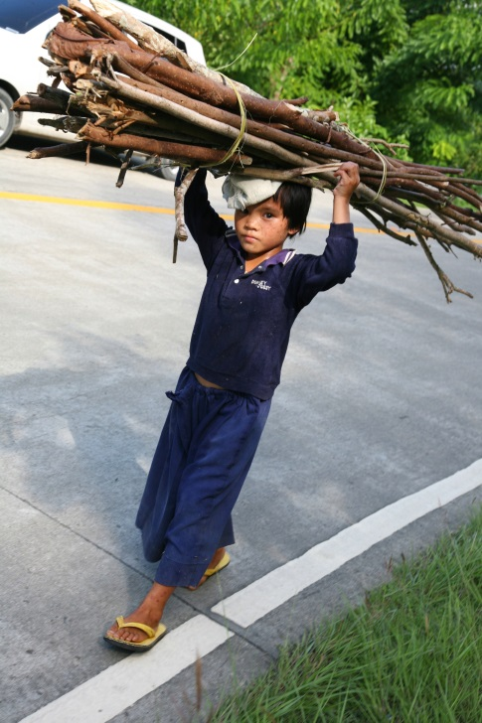
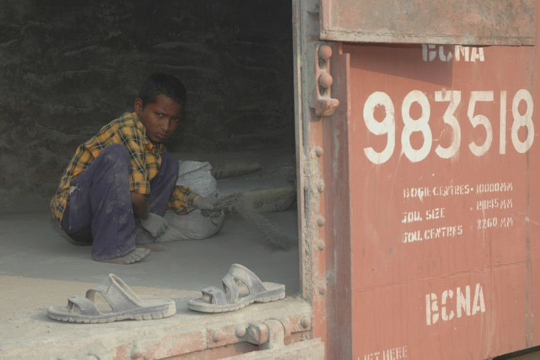
What is Child Labour?
Refers to work undertaken by children under the age of 15 that may damage health and development and that interferes with their opportunity to attend compulsory school
Children between the ages of 13 and 15 may be engaged in light work, that is, certain types of work that is not harmful and does not interfere with schooling
Children under the age of 18 should not be engaged in hazardous or high-risk work

Slide 32
Child labour: Key Elements
Suppliers should not hire underage workers in violation of domestic laws or international standards.
The worst forms of child labour as defined by Article 3 of ILO Convention No. 182:
  All forms of slavery or practices similar to slavery, such as the sale and trafficking of children, debt bondage and serfdom and forced or compulsory labour, including forced or compulsory recruitment of children for use in armed conflict
  The use, procuring, or offering of a child for prostitution, for the production of pornography or for pornographic performances
  The use, procuring, or offering of a child for illicit activities, in particular for the production and trafficking of drugs as defined in the relevant international treaties
  Work which, by its nature or the circumstances in which it is carried out, is likely to harm health, safety and morals of children
  Work with Human Resources and local legal counsel to provide examples of compliance with local laws related to child labour.

Slide 33
Child Labour: Key Elements (cont.)
Company practices that demonstrate good practice on child labour issues may include:
Adhere to minimum age provisions of national labour laws and regulations and, where national law is insufficient, take account of international standards
Use adequate and verifiable mechanisms for age verification upon recruitment
Maintain accurate and up-to-date records of all employees
When children below the legal working age are found in the workplace, take measures to remove them from work and to the extent possible, help the child removed from workplace and his/her family to access adequate services and viable alternatives
Exercise influence on subcontractors, suppliers and other business partners to combat child labour
Consider ways to build the capacity of business partners to combat child labour, such as the provision of training and incentives
Fix the wage level for the adult employees so that they can support their families without depending on children’s earning
Notes:
Taken from ILO Business Helpdesk: http://www.ilo.org/empent/areas/business-helpdesk/faqs/WCMS_DOC_ENT_HLP_CHL_FAQ_EN/lang--en/index.htm

Slide 34
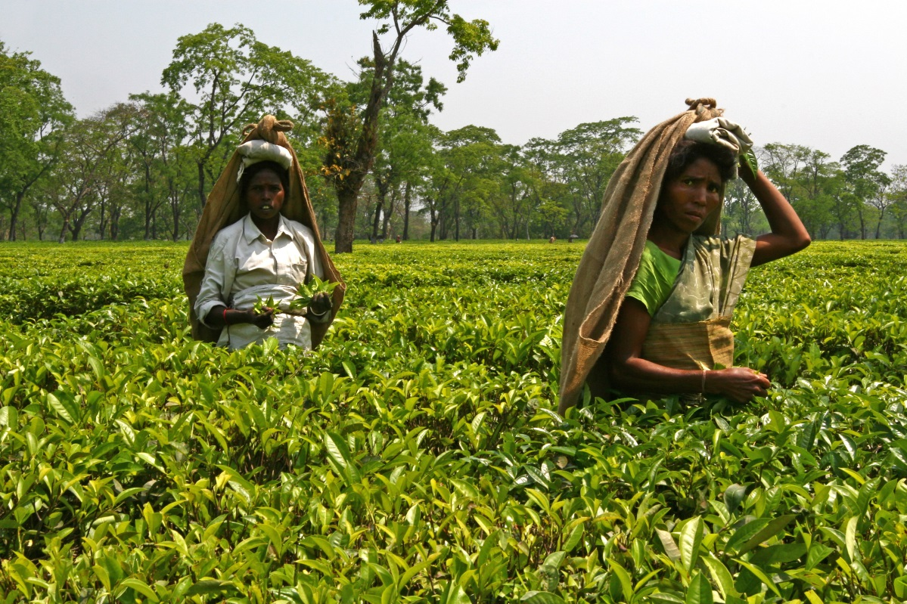
What is Forced Labour?
“Forced labour is all work or service that is extracted from any person under the menace of any penalty and for which said person has not offered voluntarily”
International Labour Organization

Slide 35

What is Forced Labour?
Keeping someone in forced labour by threatening them with:
Imprisonment or physical confinement
Deportation
Dismissal from current employment, exclusion from future employment, shift to event worse working conditions
Loss of social status, exclusion from community and social life
Deprivation of food, shelter, or other necessities

Slide 36
Forced Labour: Key Elements
Lack of consent to work:
Retaining the identity cards, passports, and other important personal documents of employees
Hiring workers into bonded labour relationships involving salary advances or loans
Withholding wages in an attempt to coerce additional labour from employees, or demanding money deposits
Restricting the ability of employees to move around and leave the workplace and housing facilities, above and beyond “reasonable” restrictions
Work with Human Resources and local legal counsel to provide examples of compliance with local laws related to forced labour.

Slide 37
What is Human Trafficking?
Human trafficking occurs both across borders and within a country
Kinds of trafficking:
Trafficking for forced labour occurs when the movement of people for the purpose of forced labour and services usually involves an agent or recruiter, a transporter, and a final employer who will derive a profit from the exploitation of the trafficked person
Trafficking for forced sexual exploitation includes the trafficking of women and girls for involuntary work in the sex industry – including near business sites where traffickers can benefit from the demand for sexual services by contractor employees

Slide 38
Human Trafficking – Key Elements
Act (What is done):
Recruitment, transportation, transfer, harbouring or receipt of persons
Means (How it is done):
Threat or use of force, coercion, abduction, fraud, deception, abuse of power or vulnerability, or giving payments or benefits to a person in control of the victim
Purpose (Why it is done):
For the purpose of exploitation, which includes exploiting the prostitution of others, sexual exploitation, forced labour, slavery or similar practices and the removal of organs
Work with Human Resources and local legal counsel to provide examples of compliance with local laws related to human trafficking.

Slide 39
Forced Labour and Human Trafficking:
Key Elements (cont.)
Company practices that demonstrate good practice on forced labour issues may include:
Ensure that workers always have free access to their documentation, including passports, identity papers and travel documents
Have a clear and transparent company policy, setting out the measures taken to prevent forced labour and trafficking. Clarify that the policy applies to all enterprises involved in a company’s product and supply chains
Monitor carefully the agencies that provide contract labour, especially across borders, blacklisting those known to have withheld documents of workers to prevent them freely leaving if they so choose
Notes:
Taken from ILO Business Helpdesk: http://www.ilo.org/empent/areas/business-helpdesk/faqs/WCMS_DOC_ENT_HLP_FL_FAQ_EN/lang--en/index.htm#Q1

Slide 40



What is Elimination of Discrimination in Respect of Employment and Occupation?
“Everyone is entitled to all the rights and freedoms set forth in this Declaration [the Universal Declaration of Human Rights], without distinction of any kind, such as race, color, sex, language, religion, political or other opinion, national or social origin, property, birth or other status.”
- Universal Declaration on Human Rights, Art. 2.

Slide 41
What is Elimination of Discrimination in Respect of Employment and Occupation?
Direct discrimination occurs whenever a company policy, practice or procedure specifically targets a particular group of people because of a distinguishing personal characteristic, and treats that group worse than others
Indirect discrimination occurs when the result of the practical application of a company policy, procedure or practice negatively impacts a particular individual or group of people, even if the content of the policies, procedures or practices appear neutral

Slide 42
Elimination of Discrimination in Respect of Employment and Occupation: Key Elements
Discrimination in employment and occupation means treating people differently and less favorably because of characteristics that are not related to their qualifications for the job, or the requirements and their performance of the job.
According to ILO Convention No. 111, these characteristics include:
  Race
  Color
  Sex
  Religion
  Political opinion
  National extraction or social origin
  Other grounds specified by national law
Work with Human Resources and local legal counsel to provide examples of compliance with local laws related to elimination of discrimination with regard to employment and occupation.

Slide 43
Elimination of Discrimination in Respect of
Employment and Occupation: Key Elements (cont.)
Company practices that demonstrate respect for elimination of discrimination may include:
Conduct an assessment to determine if discrimination is taking place within the enterprise
Set up an enterprise policy establishing clear procedures on non-discrimination and equal opportunities; and communicate it both internally and externally
Provide training at all levels of the organisation, in particular for those involved in recruitment and selection, as well as supervisors and managers, to help raise awareness and encourage people to take action against discrimination
Support on-going sensitization campaigns to combat stereotypes
Notes:
Taken from ILO Business Helpdesk: http://www.ilo.org/empent/areas/business-helpdesk/faqs/WCMS_DOC_ENT_HLP_BDE_FAQ_EN/lang--en/index.htm

Slide 44

Elimination of Discrimination in Respect of
Employment and Occupation: Key Elements (cont.)
Company practices that demonstrate respect for elimination of discrimination may include (continued):
Modify work organization and distribution of tasks as necessary to avoid negative effects on the treatment and advancement of particular groups of workers. This includes measures to allow workers to balance work and family responsibilities.
Ensure equal opportunity for skills development
Address complaints, handle appeals and provide recourse to employees in cases where discrimination is identified
Notes:
Taken from ILO Business Helpdesk: http://www.ilo.org/empent/areas/business-helpdesk/faqs/WCMS_DOC_ENT_HLP_BDE_FAQ_EN/lang--en/index.htm

Slide 45
Part 4
Supply Chain Focus: Key labour Issues for the Oil and Gas Industry

Slide 46
Potential Risk in the Supply Chain
Local suppliers and contractors may have poor general labour practices towards employees, including discrimination based on gender, ethnicity or disability, no written contracts, poor health and safety standards, excessive hours, poor accommodation, and/or lack of sanitation or privacy
Local suppliers and contractors may also knowingly or unknowingly use child labour, forced labour, and/or trafficked persons in the workforce
In some countries there can be prevailing social attitudes (e.g. degree of tolerance) toward poor labour practice or these forms of labour
These forms of labour can pose a reputational risk to a company, and in some cases wrongly accuse a company of complicity, e.g. ‘we condone the use of forced labour’
Local issues can get magnified globally through NGO campaigns, mobile technologies and social media
Local suppliers / sub-contractors
Local suppliers / sub-contractors
Key Suppliers / Contractors
Company
Supply Chain

Slide 47
Supplier Engagement Guidance
Supplier engagement guidance provides supply chain and procurement practitioners with a tool to engage with key suppliers on human rights commitments, including labour rights. It is a way to build internal awareness and capability among key suppliers.
Engagement can include:
  Annual supplier letters
  Supplier forums
  Orientations and Pre-job meetings
  Contract requirements
  Audits
  Field visits
  Training

Slide 48
Supplier Engagement
Engagements should reflect local and contract-specific labour issues and regulatory requirements. Each supplier is responsible for managing those expectations within its group, including subcontractors
Suppliers should recognize and respect the right of employees to form labour unions and bargain collectively where such rights are recognized by local law. Measures should be taken to allow workers to have a forum for discussing terms of employment and for filing and correcting grievances
Suppliers’ hiring practices and policies, employment conditions and benefits and general operating practices should be non-discriminatory and based on objective criteria such as the nature of the work tasks and the skills, experience, and qualifications of the workers
Suppliers should not participate in or benefit from any form of forced labour. Forced labour may include bonded labour, debt bondage, forced prison labour, slavery, servitude or human trafficking. Suppliers should not hire underage workers in violation of domestic laws or international standards

Slide 49
[insert company name] expectations regarding Supplier Engagement
Insert description of company policies or guidelines on supplier engagement.
[Note: your legal team should be consulted before examples are used. Documentation might be confidential or privileged.]

Slide 50
Part 5
Labour Issue Dilemmas for Discussion

Slide 51
Dilemma 1
[INSERT COMPANY NAME] is operating in a country where law prohibits full recognition of the right to freedom of association.
What can be done to influence and support suppliers/contractors in meeting international labour standards to the fullest extend permitted under national law?

Slide 52
Dilemma 1 (cont.)
What can be done to influence and support suppliers/contractors in meeting international labour standards to the fullest extend permitted under national law?
Teaching/discussion points
The company can use its leverage to discuss with the supplier why it is important and beneficial to respect the rights of workers to organise to the extent permitted
If trade unions are not allowed under national law, collective bargaining can be undertaken by any appointed representative that is genuinely representative of workers and their interests
Worth noting the alignment of business practice with the UNGPs. Guiding Principle 19 explains:
“If the business enterprise has leverage to prevent or mitigate the adverse impact, it should exercise it. And if it lacks leverage there may be ways for the enterprise to increase it. Leverage may be increased by, for example, offering capacity-building or other incentives to the related entity, or collaborating with other actors. There are situations in which the enterprise lacks the leverage to prevent or mitigate adverse impacts and is unable to increase its leverage. Here, the enterprise should consider ending the relationship, taking into account credible assessments of potential adverse human rights impacts of doing so. Where the relationship is “crucial” to the enterprise, ending it raises further challenges.”

Slide 53
Dilemma 2
[INSERT COMPANY NAME] is using contracted labour in the construction phase of an operation. Many of the workers are immigrants.
How would you assess the potential risk?

Slide 54
Dilemma 2 (cont.)
How would you assess the potential risk?
Teaching/discussion points
It is important for companies to engage with suppliers to support their respect for human rights, including on freedom of association and collective bargaining, prohibition of underage workers, prohibition of recruitment, use and practices of forced labour, prohibition of discrimination in hiring practices and working conditions (e.g. health and safety). Where there are potentially higher risk of these labour issues, such as with migrant work forces, there are existing company tools and processes that may help to assess risk:
Compliance reviews with national laws and regulations
Periodic review of feedback from supplier engagement sessions and forums
Periodic audits of suppliers
Pre-qualification supplier screening processes
Periodic review of compliance with requirements in supplier contracts

Slide 55

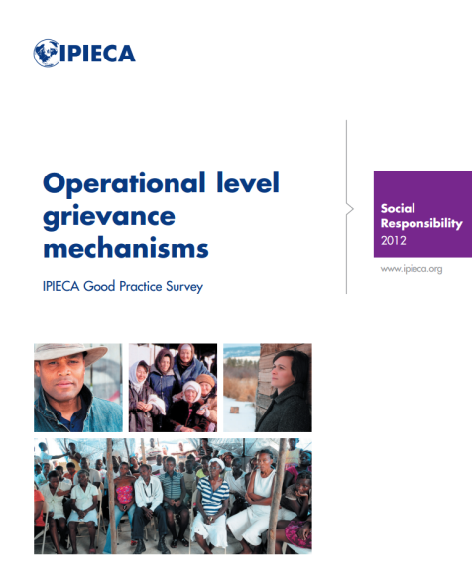
External Resources
IPIECA
Indigenous Peoples and the oil and gas industry: context, issues and emerging good practice
Guide to successful, sustainable social investment for the oil and gas industry
Voluntary Principles on Security and Human Rights: Implementation Guidance Tool
A guide to social impact assessment in the oil and gas industry
www.ipieca.org
External
Voluntary Principles on Security and Human Rights
  http://voluntaryprinciples.org
International Finance Corporation (IFC) Performance Standards
  http://www1.ifc.org/wps/wcm/connect/topics_ext_content/ifc_external_corporate_site/ifc+sustainability/publications/publications_handbook_pps
United Nations Guiding Principles on Business and Human Rights
  http://www.ohchr.org/documents/issues/business/A.HRC.17.31.pdf
International labour Organization Core Labour Standards
  http://www.ilo.org/global/standards/subjects-covered-by-international-labour-standards/lang--en/index.htm
International Labour Organization “Helpdesk for Business, the one-stop shop for company managers and workers on how to better align business operations with international labour standards and build good industrial relations”
  http://www.ilo.org/empent/areas/business-helpdesk/lang--en/index.htm

